Slide 1

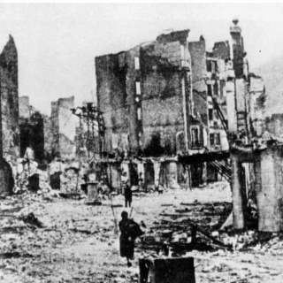
The Spanish Civil War
Conflict, Ideology, and Prelude to World War II

Slide 2

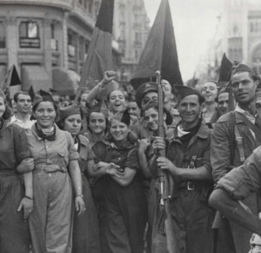
Historical Context: A Divided Spain
A Nation in Crisis
By 1936, Spain was polarised. The Second Republic (1931) faced fierce opposition from traditional elites.
Key Tensions
Land Reform: Peasants wanted land from the Church and aristocracy.
The Church: Anti-clerical violence versus Catholic power.
Regionalism: Catalonia and the Basque Country sought autonomy.

Slide 3
The Road to War (1931–1936)
1934
1934: Right-Wing Turn
The Radical Party rolls back reforms; the Asturias uprising is crushed.
July 1936
The Coup
Generals launch an uprising,marking the start of the war.
1931
1931: Second Republic
King Alfonso XIII abdicates.New constitution established.
February 1936
1936: Popular Front
Left coalition wins election,polarising the country.

Slide 4
The 1936 Election: The Popular Front
The Popular Front (Left)
A coalition of republicans, socialists, and communists.
Their Goals
Continue land reform.
Grant regional autonomy.
Reduce military power.
Outcome: Narrow victory with 268 seats.
The National Front (Right)
A coalition of monarchists, Catholics, and the CEDA (fascists).
Their Fears
Communist revolution.
Destruction of the Church.
Loss of traditional Spanish unity.
Outcome: Refused to accept the results; plotted the coup.

Slide 5
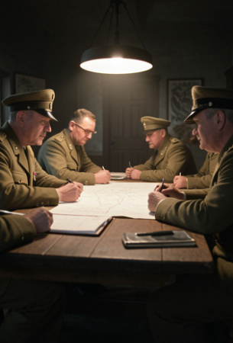
The Trigger: The Military Uprising
The Plan
General Francisco Franco, stationed in Morocco, joined other generals (Mola, Goded) in a coup to overthrow the Republic.
The Result
The coup failed to capture the key cities of Madrid and Barcelona. Instead of a quick takeover, Spain was split in half. The failure of the coup marked the beginning of a long and bloody civil war.

Slide 6
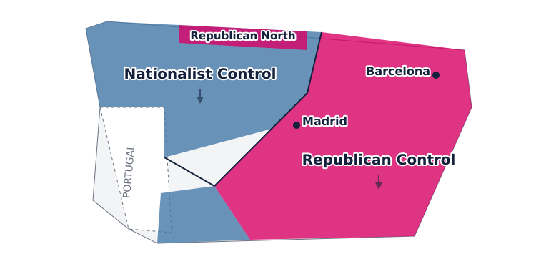
Spain Divided: The Two Zones

Slide 7

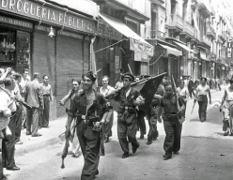
Historical Debate
Why did the military coup of July 1936 fail to seize power quickly?

Slide 8
Historical Debate
✅​
You might have said...
Generals underestimated the loyalty of Civil Guard and police in key cities.
Workers' militias and trade unions mobilised to defend the Republic.
The government kept the navy, blocking the Army of Africa from Morocco.

Slide 9
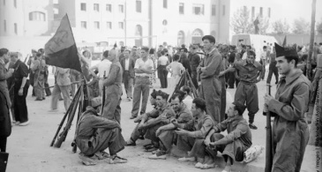
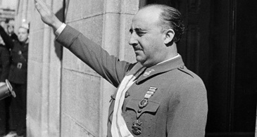
The Factions: Republicans vs Nationalists
The Republicans (Loyalists)
The legitimate government of Spain. A coalition of left-wing groups.
Ideals: Democracy, Socialism, Anarchism, Anti-Fascism.
The Nationalists (Rebels)
The military uprising led by Franco. A coalition of right-wing groups.
Ideals: Fascism, Monarchism, Conservatism, Catholicism.

Slide 10
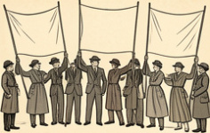
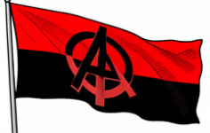

Internal Divisions: The Republicans
1
2
3
Socialists (PSOE)
Wanted a democratic socialist revolution but were often moderate.
Anarchists (CNT-FAI)
Sought a stateless society; strongest in Catalonia and Aragon.
Communists (PCE)
Prioritised winning the war over revolution; controlled by Moscow.

Slide 11
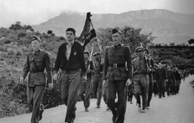
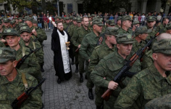
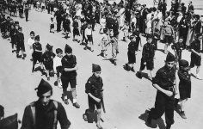
Internal Unity: The Nationalists
1
2
3
The Army
The core of the movement, led by experienced generals like Franco.
The Church
Presented the war as a 'Crusade' against godless Communism.
The Falange
The Fascist party providing militia support and ideological fervour.

Slide 12
Understanding the Conflict
The Nationalists were more united in their leadership and goals than the Republicans.
👍​
👎​
TRUE
FALSE
Now it's time to explain why...

Slide 13
Understanding the Conflict
The Nationalists were more united in their leadership and goals than the Republicans.
👍​
Why is that?
a) The Republicans had a clear military hierarchy led by a single general, while the Nationalists relied on chaotic militia leadership.
b) Franco established a unified command structure, whereas Republicans were divided between anarchists, communists, and socialists who fought each other.
Answers on the next slide...

Slide 14
Understanding the Conflict
✅​
The Nationalists were more united in their leadership and goals than the Republicans.
👍​
Why is that?
a) The Republicans had a clear military hierarchy led by a single general, while the Nationalists relied on chaotic militia leadership.
b) Franco established a unified command structure, whereas Republicans were divided between anarchists, communists, and socialists who fought each other. ✅​

Slide 15
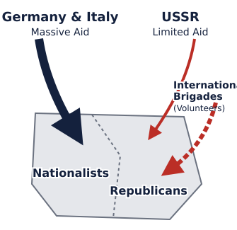
Foreign Intervention: Internationalisation
The Non-Intervention Committee
Britain and France proposed a non-intervention agreement to avoid escalating the conflict into a European war.
The Reality
This policy effectively doomed the Republic. While the democracies stood back, Hitler and Mussolini sent massive aid to Franco, turning Spain into a testing ground for World War II weaponry and tactics.

Slide 16
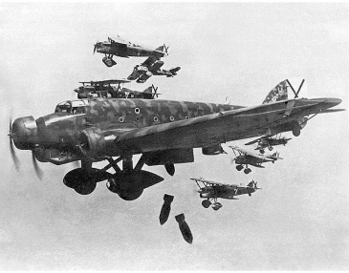
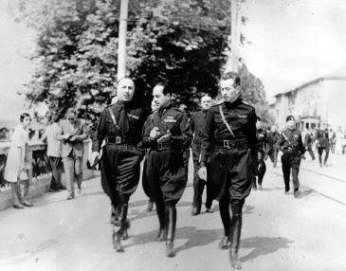
The Axis Powers: Germany and Italy
Hitler and Mussolini sent troops, aircraft (the Condor Legion), and weapons to support Franco.

Slide 17
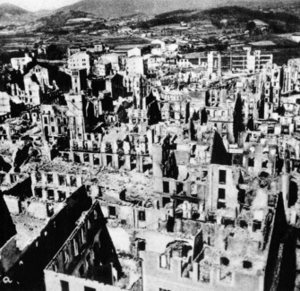
Guernica: The Horror of Modern Warfare
26 April 1937
The German Condor Legion bombed the Basque town of Guernica. It was the first aerial bombing of a civilian population in history.
The Impact
The town was destroyed for no strategic military purpose. It served as a terror tactic and a demonstration of Nazi air power. Pablo Picasso's famous painting immortalised the tragedy.

Slide 18
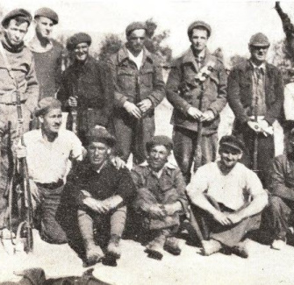
Soviet Support and the International Brigades
Soviet Union
Stalin sent advisors, tanks, and aircraft, but demanded gold payment and political control over Republican strategy.
International Brigades
Over 40,000 volunteers from 53 countries (including Britain, France, and the US) came to fight for the Republic. They were organised by Communists but driven by anti-fascist idealism.
"Better to die on one's feet than to live on one's knees."

Slide 19
Foreign Intervention Quiz
Answers on the next slide...
Which country effectively blocked the Republic from buying arms by enforcing a 'Non-Intervention' blockade?
1.
Germany
2.
Italy
3.
France and Britain
4.
The United States

Slide 20
Foreign Intervention Quiz
✅​
Which country effectively blocked the Republic from buying arms by enforcing a 'Non-Intervention' blockade?
1.
Germany
2.
Italy
3.
France and Britain
👍​
4.
The United States

Slide 21
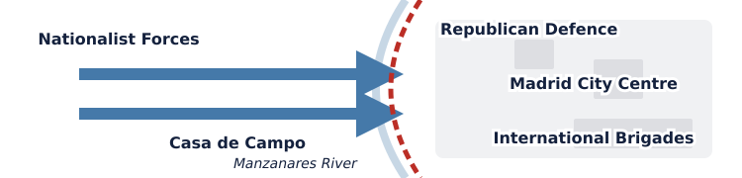
The Battle of Madrid (Nov 1936)
Franco's goal was a quick capture of the capital to decapitate the Republic.
Republican militias, including the International Brigades, halted the advance. The famous slogan "No pasarán" (They shall not pass) was born.

Slide 22
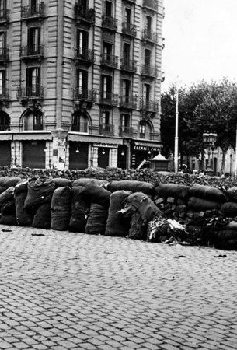
The Disunity of the Left
The May Days (1937)
In Barcelona, fighting broke out between the Communist-backed government forces and the Anarchists (POUM/CTV).
The Consequence
Instead of fighting Franco, the Left was fighting itself. This internal conflict weakened the Republican front and allowed the Nationalists to regroup. It highlighted the ideological 'Civil War within the Civil War'.

Slide 23
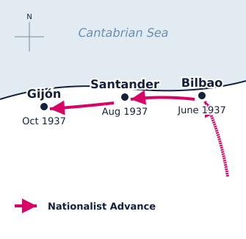
The War in the North
1937 Campaign
With the North isolated, the Nationalists launched a brutal campaign to conquer the Basque Country and Asturias.
Key Events
Bombing of Guernica: Psychological warfare to break Basque morale.
Fall of Bilbao: The industrial heartland was lost to Franco's forces.
Santander and Gijón: By late 1937, the entire North coast was in Nationalist hands.

Slide 24
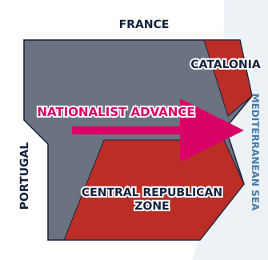
The Aragon Offensive
Breaking the Stalemate
By March 1938, Franco reached the Mediterranean Sea, splitting Republican territory in two.
The Result
Catalonia was now cut off from the rest of Republican Spain.
The Republic could no longer move supplies between the northern and southern fronts.
France briefly opened the border, allowing limited supplies to reach Catalonia, but it was too little, too late.

Slide 25
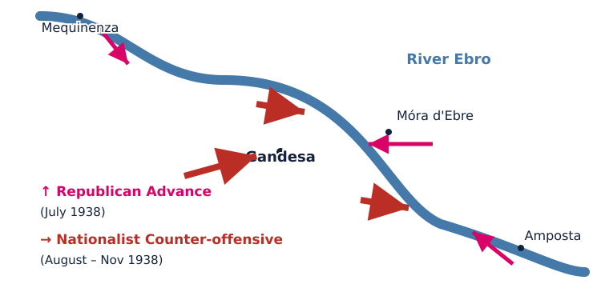
The Battle of the Ebro (1938)

Slide 26
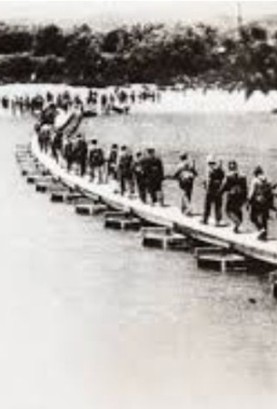
The Battle of the Ebro: The Last Gasp
The Plan
The Republican army launched a massive surprise crossing of the Ebro River in July 1938. It was the largest offensive of the war and the last chance to relieve the pressure on Catalonia.
The Outcome
Initial success turned into disaster. The Nationalists, with superior air power and supplies, counter-attacked over four months. The Republic lost over 60,000 casualties—men and weapons they could not replace.

Slide 27
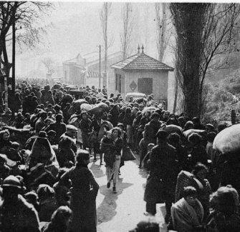
The Fall of Catalonia
December 1938 - February 1939
Franco launched the final offensive against Catalonia.
The Collapse
Barcelona fell in January 1939.
The Retreat: Nearly half a million civilians and soldiers fled across the border into France, where they were interned in harsh camps on the beaches.
With the industrial base gone, the Republic was militarily finished.

Slide 28
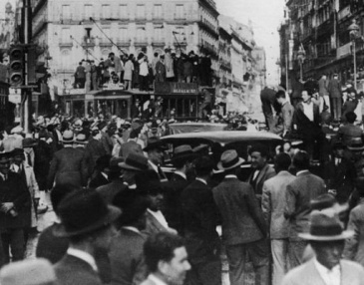
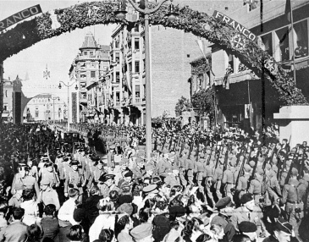
The End of the War
After a military coup in Madrid (Casado), the Republican defence collapsed. Franco entered Madrid on 1 April 1939.

Slide 29
Timeline of Key Events
Answers on the next slide...
Put these major events of the war in chronological order.
Guernica Bombing
Battle of the Ebro
Fall of Barcelona
Popular Front Wins Election

Slide 30
Timeline of Key Events
✅​
Put these major events of the war in chronological order.
Guernica Bombing
1.
Popular Front Wins Election
2.
Fall of Barcelona
3.
Battle of the Ebro
4.

Slide 31
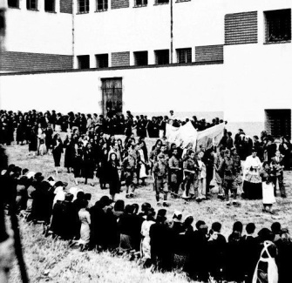
The Aftermath: Repression
The White Terror
Victory was followed by a systematic purge of the 'Red' Spain.
Statistics
Executions: Estimates range from 50,000 to 200,000 killed in the post-war period.
Concentration Camps: Hundreds of thousands were imprisoned in forced labour camps.
Exile: Intellectuals, artists, and politicians fled into exile for decades.

Slide 32
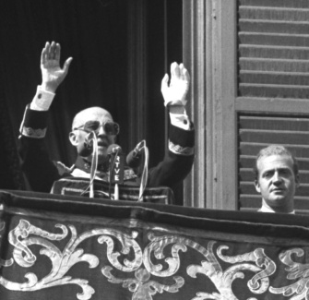
The Franco Dictatorship
A New Spain
Franco established a personal dictatorship that lasted until his death in 1975.
Characteristics
Autarky: Economic self-sufficiency led to poverty and rationing.
Catholicism: The Church regained immense power over education and morals.
Censorship: Strict control of press and culture.
Isolation: Spain was ostracised by the UN until the Cold War.

Slide 33
Key Terminology
1.
Fifth Column
a)
A violent attempt to overthrow a government (referring to the 1936 coup).
2.
Putsch
b)
A group of secret sympathisers or supporters of an enemy within a country.
3.
Autarky
c)
An economic policy of self-sufficiency, avoiding trade with other nations.
4.
Carlists
d)
Traditionalist royalists who supported the Nationalist claimants to the throne.

Slide 34
Key Terminology
✅​
1.
Fifth Column
b)
A group of secret sympathisers or supporters of an enemy within a country.
2.
Putsch
a)
A violent attempt to overthrow a government (referring to the 1936 coup).
3.
Autarky
c)
An economic policy of self-sufficiency, avoiding trade with other nations.
4.
Carlists
d)
Traditionalist royalists who supported the Nationalist claimants to the throne.

Slide 35
Historical Significance
The Spanish Civil War is often described as the 'dress rehearsal' for World War II.
👍​
👎​
TRUE
FALSE
Now it's time to explain why...

Slide 36
Historical Significance
The Spanish Civil War is often described as the 'dress rehearsal' for World War II.
👍​
Why is that?
a) It was a direct conflict between Spain and its neighbours over border disputes that escalated into World War II.
b) It involved the major European powers testing new military tactics (blitzkrieg, terror bombing) and ideologies (Fascism vs Communism) on Spanish soil.
Answers on the next slide...

Slide 37
Historical Significance
✅​
The Spanish Civil War is often described as the 'dress rehearsal' for World War II.
👍​
Why is that?
a) It was a direct conflict between Spain and its neighbours over border disputes that escalated into World War II.
b) It involved the major European powers testing new military tactics (blitzkrieg, terror bombing) and ideologies (Fascism vs Communism) on Spanish soil. ✅​

Slide 38
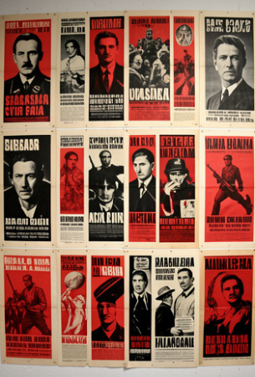
Foreign Correspondents and Art
The Media War
This was the first 'media war'. Writers like George Orwell (Homage to Catalonia) and Ernest Hemingway (For Whom the Bell Tolls) brought the conflict to the world's attention.
Propaganda
Both sides used posters and film extensively. The Republicans appealed to anti-fascist sentiment, while the Nationalists appealed to religious and traditional values.

Slide 39
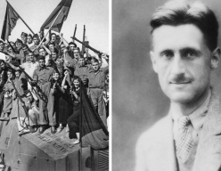
IB Exam Practice
To what extent was the disunity of the Republican political forces the main reason for Franco's victory in the Spanish Civil War?

Slide 40
IB Exam Practice
✅​
You might have said...
Foreign aid: Germany/Italy backed Franco; the Republic was blockaded.
Military: Franco unified command; Republicans remained divided.
Internal conflict: The May Days weakened the Republic significantly.
Counter-argument: Even if unified, the Republic lacked heavy weaponry.

Slide 41

Reviewing the Facts
The bombing of ____ by the ____ Legion in 1937 shocked the world and was depicted by Pablo Picasso.
Word bank 🏦​
Guernica, Condor, Madrid, Barcelona, International, Blue
Answers on the next slide...

Slide 42
Reviewing the Facts
✅​
The bombing of Guernica by the Condor Legion in 1937 shocked the world and was depicted by Pablo Picasso.
Word bank 🏦​
Guernica, Condor, Madrid, Barcelona, International, Blue

Slide 43

Quick Check
Question 1:
Who was the leader of the Nationalist forces?
Question 2:
Which two fascist powers intervened on the side of the Nationalists?
Question 3:
What was the name of the volunteer units fighting for the Republic?
Answers on the next slide...

Slide 44
Quick Check
✅​
Answer 1:
General Francisco Franco
Answer 2:
Germany and Italy
Answer 3:
The International Brigades

Slide 45
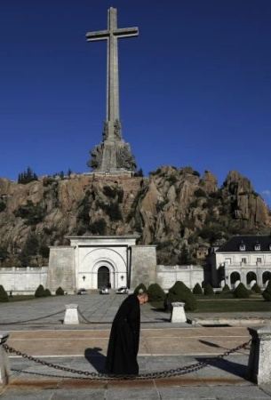
Historical Memory
The Pact of Forgetting
After Franco's death, Spain transitioned to democracy through an agreed 'Pact of Forgetting' to avoid reopening old wounds.
Modern Reckoning
Only recently, with the Law of Historical Memory (2007), has Spain begun to officially recognise the victims of the Republican side and excavate mass graves. The war remains a sensitive and pivotal topic in Spanish history.

Slide 46
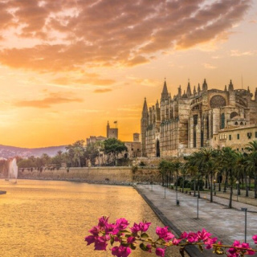
Lesson Summary
A conflict of ideologies that shaped the 20th Century

